Slide 1
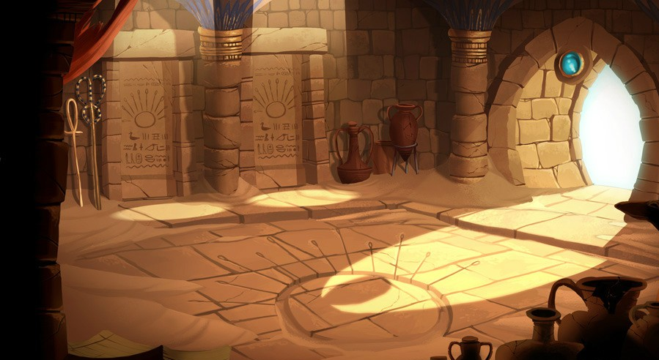
Finding Dawn
If you move, you survive
Silly Arts Games

Slide 2
Silly Arts Games
Software Engineer / Project Manager - Harshil
Graphic Designer/ QA Tester - Pragnesh
Artist + Sound Engineer - Dylan

Slide 3
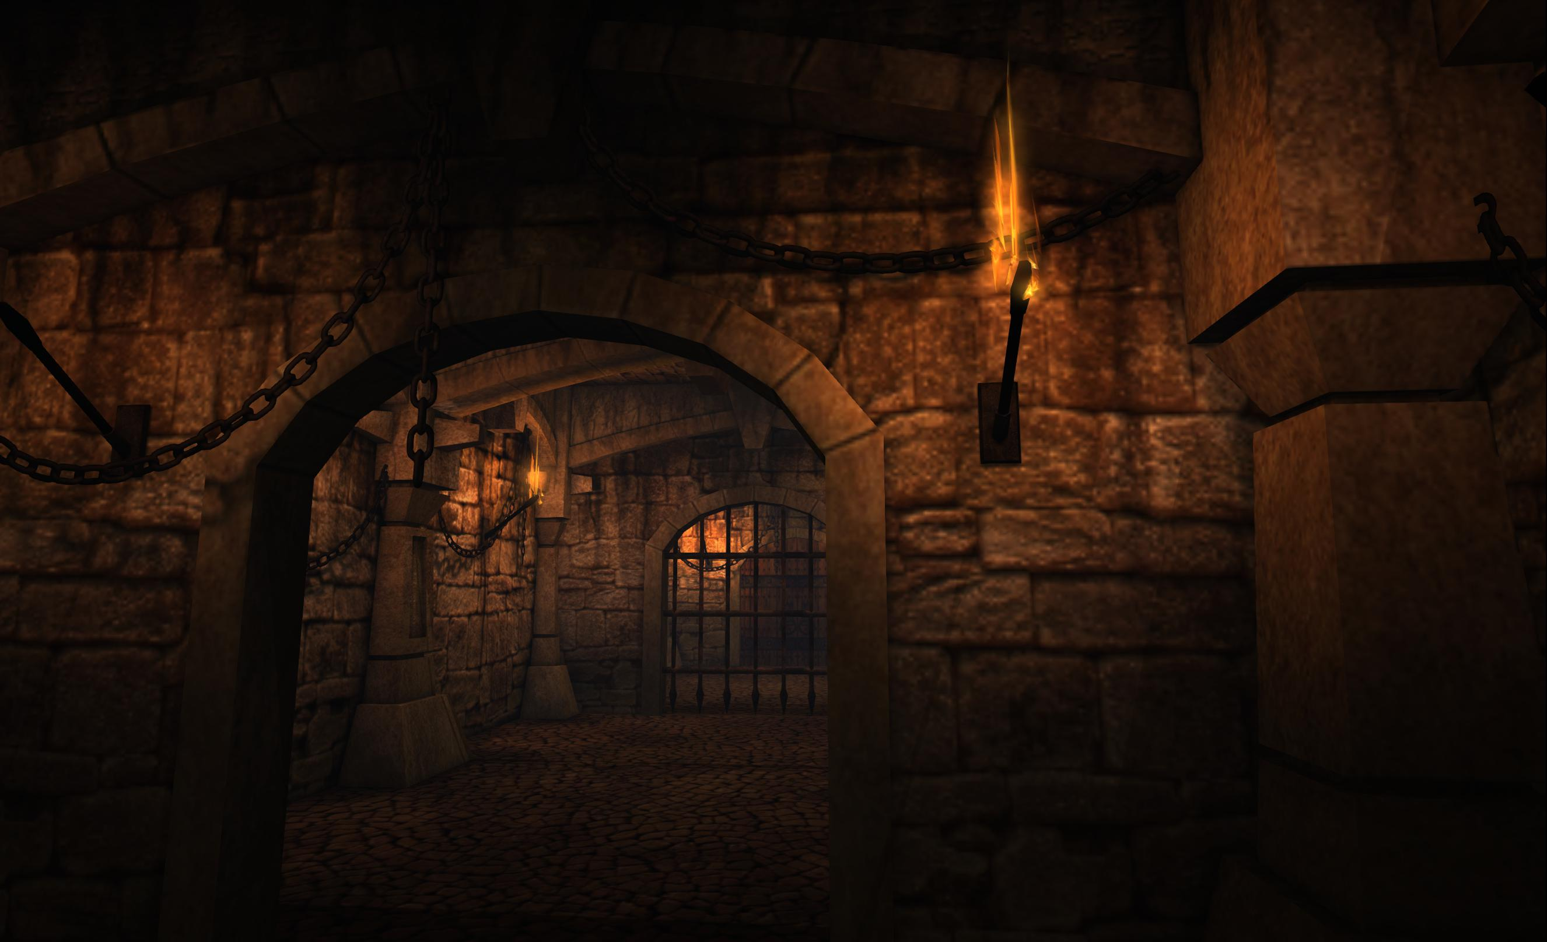
Finding Dawn
A 2D dungeon game where player has to find their way out to see the daylight after being trapped somewhere underground for long time.

Slide 4
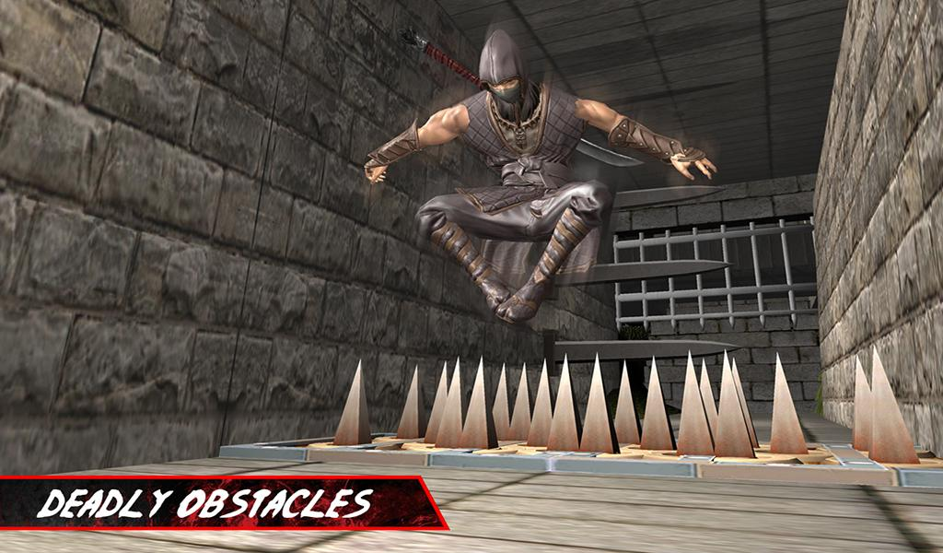
Game Atmosphere
Player start from somewhere inside dungeon
It’s single player game. Game has 3 Levels
Players has to find way out to see the daylight within given time for Each Level
Notes:
Defeat the army and leader to go to the next level and eventually defeat the alpha leader

Slide 5
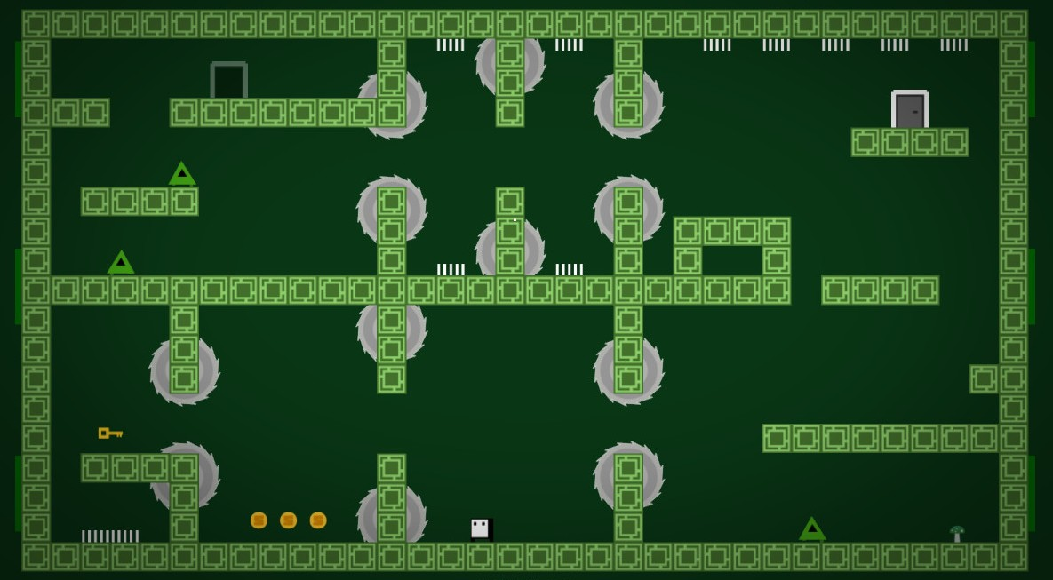
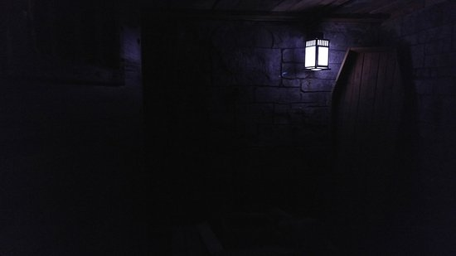
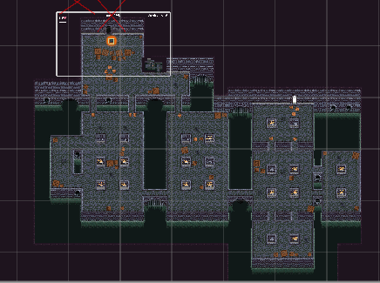
Game Planning
Daylight (Movie)
Game ideas from Prince, Dungeon Crawler, Deep Dark Dungeon

Slide 6



Game Elements
Destructible objects/obstacles: creepy creatures
Non Destructible objects :
Spikes, Dungeon walls
Weapons: Kill enemies by shooting knife
Collectables:
Health, Time Boosts, Speed Power Ups
Collect movement speed powerups, health and Timer on the way to finish the goal.
Notes:
Defeat the army and leader to go to the next level and eventually defeat the alpha leader

Slide 7
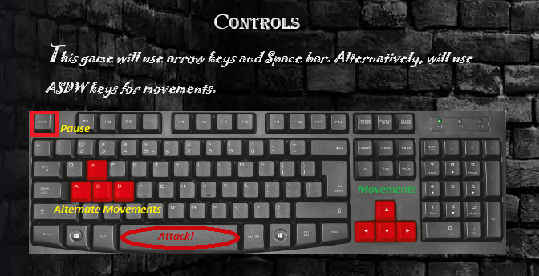
Gameplay Controls
Mechanics:
Moving in left-right-up-down
Use Space key to attack with knife
to kill the enemy

Slide 8

Game Demo
https://harshilme2.itch.io/findingdawn

Slide 9



Lesson Learned -
Bugs and Defect solving
Communication
Time Management
How to design game
Github, Unity project management environment

Slide 10

Future Possibilities-
Artificial intelligence movement of enemies
Upgrade game to 3D platform
Mobile Platform Implementation

Slide 11

THANK YOU Questions?

